Slide 1

Mr.Udayakumar.HM
MBA, MA, M.Ed., M.Phil. (Ph.D.), KSET
Assistant Professor
Department of Humanities
M.S. Ramaiah Institute of Technology,
Bengaluru, Karnataka-54

Slide 2
PROFESSIONAL COMMUNICATION
AND
LIFE SKILLS
BE-Semester: 2
Term: 10.05.2021 to 03.08.2021
Course Code: HS24 Credits: 2:0:0

Slide 3
COURSE OUTCOMES
Students will be able to
Understand the basic concepts of Communication. (PO10, PO12)
Inculcate Listening & Speaking Skills accurately. (PO10, PO12)
Develop reading skills, writing skills & grammar accuracy. (PO9, PO10, PO12)
Reinforce human values and cultural sensibilities. (PO9, PO12)
Learn the life skills required for self-management. (PO9, PO12)

Slide 4
COURSE ASSESSMENT AND EVALUATION
 | What | To Whom | When/ W here (Frequency in the course) | Max Marks | Evidence Collected | Contributing to Course Outcomes
C I E | Internal assessment tests | Students | Two Tests (Average of the two will be computed) | 30 | Blue Books | 1 to 5
 | Creative writing Lab Component | Students | Assignment-1 (10) Assignment-2 (10) | 20 | Answering Assignment Questions. | 1 to 5
 |  |  | ----- | ----- | ----- | ------
 |  |  | ------ | ------ | ---- | ----
S E E | Standard examination Students Feedback | Students | End of course (Answering 5 of 10 questions) Middle of the Course | 100 | Answer scripts Feedback Forms | 1 to 5
 | End of course Survey |  | End of course | - | Questionnaire | --

Slide 5
EVALUATION METHOD
CIE-Test | Marks | Lo | Co | Marks | Final Marks
Test: 1 | 30 | 1 to 5 | 1 to 5 | 30 | 30
Test: 2 | 30 | 1 to 5 | 1 to 5 | 30 | 30
 | 60 | Average |  | 30 | 30
CIE-Assignment | Marks | Lo | Co | Marks | Final Marks
Assignment: 1 | 10 | 1 to 5 | 1 to 5 | 10 | 20 20
Assignment: 2 | 10 | 1 to 5 | 1 to 5 | 10
 | Marks | Lo | Co | Marks | Final Marks
SEE | 100 | 1 to 5 | 1 to 5 | 100 | 50
 |  | Scale Down to |  | 50
 |  |  |  | Total | 100

Slide 6
Questions for CIE and SEE will be designed to evaluate the various
educational components (Bloom’s taxonomy) such as:
CIE and SEE Evaluation:
SL .No | Bloom’s Category | Test 1 | Test 2 | SEE
1 | Remember | 34% | 34% | 30%
2 | Understand | 55% | 20% | 30%
3 | Apply | 00% | 23% | 20%
4 | Analyse | 11% | 00% | 10%
5 | Evaluate | 00% | 00% | 00%
6 | Create | 00% | 23% | 10%

Slide 7
IMPORTANCE OF INTRODUCING SUBJECT FOR ENGINEERING STUDENTS.
For engineers to be successful over the course of their careers, communication skills are just as important as technical knowledge.
One of the best ways for engineering managers to bring value to their companies and help their own careers is by learning and practicing good communication skills.
According to researches conducted in Harvard and Stanford Universities only 15% of your career success is provided by your hard skills, whilst other 85% by so called soft skills.
“Soft skills’ get little respect but will make or break your career” (Peggy Klaus).

Slide 8
EMPLOYABILITY SKILLS OF GRADUATES IN INDIA
(The skill development landscape in India and implementing quality skill training, August 2010). Even in India, which produces 400,000 engineers annually, corporations are finding it increasingly difficult to find the qualified workers they require. (Replacement migration, 2009).
India’s National Association of Software Services Companies estimates a potential shortfall of 500,000 technology professionals by 2010 (Talent shortage survey, 2005).
There were several studies conducted in India to know the employability skills, Employability Skills -A Study on the Perception of the Engineering Students 527 of the students. It is found that 75% of the Indian graduates are unemployable. (Talent shortage survey, 2005).
Globally about 34% of the employers (Talent shortage survey, 2005) find it difficult to fill the talent gap and in India 67% of the employers find it difficult to find right talent in India (from both arts and science graduates).

Slide 9
As per the data shared by the HRD ministry, India has total 6,214 Engineering and Technology Institutions in which around 2.9 million (29 lakh) students are enrolled.
Every year on an average 1.5 million (15 lakh) students get their degree in engineering, but due to lack of skill required to perform technical jobs less than 20 percent get employment in their core domain.

Slide 10
NPTEL
National Programme on Technology Enhanced Learning
Online web portal http://nptel.ac.in
Course Name | Duration | Start date | End date | Exam date | Enrollment End date | Link
Enhancing Soft Skills and Personality | 8 Weeks | July 26, 2021 | October 15, 2021 | October 24, 2021 | August 23, 2021 | https://onlinecourses.nptel.ac.in/noc21_hs02/preview
Soft Skill | 12 Weeks | July 26, 2021 | October 15, 2021 | October 24, 2021 | August 02, 2021 | https://onlinecourses.nptel.ac.in/noc21_hs07/preview

Slide 11
SYLLABUS
UNIT-I: Fundamentals of Communication.
Fundamentals of Communication-process,
levels, forms and barriers of Communication.
General and Technical Communication.
Nonverbal Communication,
Body language and its significance.
Communication across cultures.
UNIT-II: Listening and Speaking skills.
Listening skills-Definition of Listening, Listening V/S Hearing
Barriers to listening, Types of Listening, Significance of listening
Improvising Listening Skills.
Speaking skills-Effective speaking, Presentation Strategies.
UNIT-III: Grammar, Reading skills and Professional Writing Skills.
Parts of speech, usage of tense forms, correction of sentences.
Idioms and phrases, Commonly Confused Words.
Reading skills- Reading techniques-skimming, scanning, Types of reading- intensive and extensive reading.
Writing skills- Paragraph writing, Expansion of Ideas.
Letter writing, Report writing, E-mail etiquette.
Drafting a Resume and Job application.

Slide 12
UNIT-IV: Human values and Relationship Management.
Human values- its significance, Social values, Integrity, Empathy, Character, Spirituality.
Relationship values-honesty, commitment, and compromise.
Building effective relations with peers and yourself.
Building effective relations with parents and elders.
Aspirations and parents’ expectations.
UNIT-V: Self-Management skills
Stress Management-Introduction, significance and methods of Stress Management, Methods to recognize stress.
Anger Management
Time Management
Managing Emotions
Developing the right attitude
Self-esteem-acceptance of setbacks and success,
Goal Setting.

Slide 13
Books:
Dr.Premila Swamy D & Mr.UdayaKumar.HM, Communication Skills for Engineers, Archers and Elevators Publishing House, Bangalore, India-2021.
Meenakshi Raman & Sangeetha Sharma- Technical communication – Principles and Practice Oxford University Press – 2007.
A.J. Thomson & A. V. Martinet, A Practical English Grammar, Oxford University Press –1987.
M Ashraf Rizvi, Effective Technical Communication, McGraw Hill Education (India) Private Limited-2005.
Sanjayakumar, Communication Skills, Pushp Lata, Oxford Press, 2016.
SK.Khandelwal & RK Gupta, Functional Grammar & Composition, Laxmi Publiacation (P) Ltd.
N.Krishna Murthy, Modern English Grammar, Trinity press, 2016.
John Seely, Guide to Speaking and Writing, Oxford -2000.
Larrie Rouillard,‘ Goals and goal setting-Achieve measurable results’, by Vivek Book Ptd.
Daniel Goleman's emotional intelligence why it can might have more than IQ, Bloomshurry Publishing Ptd.2017.

Slide 14
PDF and Video Lectures:
NPTEL Course: Soft skills’ by prof. Binod Mishra, Professor of English, IIT Roorkee.
NPTEL Course: ‘Developing Soft skills and Personality’, by Prof. T. Ravichandran, IIT Kanpur.
NPTEL Course: ‘Stress Management’, Prof. Rajlakshmi Guha Centre for Educational Technology IIT Kharagpur.
NPTEL Course: ‘Enhancing Soft Skills & Personality’.

Slide 15
INTRODUCTION TO COMMUNICATION AND ITS PROCESS
Introduction
Etymological meaning
The word “communication” is derived from “Communicare” or “Communis” (Latin) meaning “to share it”.

Slide 16
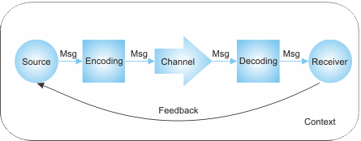
Definition communication.
Robert Anderson, “Communication is interchange of thoughts, opinions, or information, by Speech, Writing, or Signs”.
process of communication:
Components/elements of communication:
1. Sender/encoder
2. Medium
3. Channel
4. Receiver/decoder
5. Feedback
6. Context
7. Noise – Internal & External noise

Slide 17
ASSESSMENT QUESTIONS
Exercise: 1.1. Answer the following questions by choosing correct options giving below.
1. The English word ‘Communication’ is derived from the word_____ A. Communicare B. Comunnicare C. Comunicare D. Communnicare
2. ‘Communicare’ is a _____ word. A. French B. Latin C. German D. Indian
3. Define ‘Sender’
A. Transmit the message B. To decode the message
C. Sending gifts D. None
4. Define ‘Receiver’.
Words, body language that responds to the sender's message.
Words
Receives and interprets the message transmit the feedback.
Trigger words.
5. Define ‘Encoding’.
The process of finding meaning.
Transmit the message.
The process of the turning ideas and feelings into verbal and non-verbal.
Refers to words.

Slide 18
6. The process of finding meaning of ‘verbal and non-verbal’ symbols.
A. Encoding B. Decoding
C. Life D. Verbal
7. Define ‘Physical Noise’ (External noise).
Any sound that prevents a person being heard.
Any unwanted noise
Sound waves that hinders communication.
All the above
8. ‘Psychological noise’ (Internal noise).
Interference that occurs within our minds.
Thought that interfere with the message.
Both are correct.
Both are wrong.
9. True or False: is verbal actually words?
True
False
10. True or false: is the definition non-verbal communication without words.
True
False

Slide 19
Answer-Exercise: 1.1:
A. Communicare 2.B. Latin 3.A. Transmit the message
4.C. Receives and interprets the message transmit the feedback.
5. C. The process of the turning ideas and feelings into verbal and non-verbal.
6. B. Decoding
7.D. All the above
8. A. Interference that occurs within our minds.
9.A. True 10.A. True
Activity: “The meaning of communication lies in the way that is received”.
Do you agree with the above statement? Discuss with your friends during the next meeting.

Slide 20


Slide 21


Slide 22
FORMS OF COMMUNICATION
1. Types of verbal Communication |  | 2. Types of non-verbal Communication
1. Oral Communication | 1. Face-to-face Conversation 2. Telephone talk 3. Presentation 4. Public Speech 5. Interview 6. Meeting | 1. Kinesics | 1. Shrugs 2. Foot tapping 3. Drumming fingers 4. Clicking pens 5. Winking 6. Facial Expressions 7. Gestures.
2. Written Communication | 1. Letter 2. Memo 3. Notice 4. Circular 5. Report 6. Minutes | 2. Proxemics | 1. Intimate distance (0-2 ft.) 2. Personal distance (2-4ft.) 3. Social distance (4-12 ft.) 4. Public distance (>12 ft.)
 |  | 3. Paralinguistic | 1. Voice modulation 2. Pitch 3. Articulation 4. Pauses 5. Sound Symbols 6. Chronemics 7. Silence 8. Vocalic
 |  | 4. Haptic Communication | Physical intimacy: Holding hands Hugging Tickling Kissing
 |  | 5. Locomotion (Movement) | Walking, Jumping, swaying, Moving with a wheelchair
 |  | 6. Body language | 1. Facial Expressions 2. Eye-Contact (Oculesics) 3. Posture 4. Gesture 5. Personal appearance 6. Adornment

Slide 23
Types of Verbal Communication
1. Oral Communication | 1. Face-to-face Conversation 2. Telephone talk 3. Presentation 4. Public Speech 5. Interview 6. Meeting
2. Written Communication | 1. Letter 2. Memo 3. Notice 4. Circular 5. Report 6. Minutes

Slide 24
The advantages of oral communication
Time saving
Cost savings
3. More powerful
4. Effectiveness
5. Immediate feedback
6. More suitable
7. A relationship develops
8. Flexibility
9. Easiness
10. Correction of errors
11. Informal communication
12. Motivation
13. Special applications
14. Maintaining secrecy

Slide 25
Disadvantages of Oral Communication
No record
Expensive
Distortion of the word
Inaccuracy
Limited use
Probability of omitting main subject
Confused speech
No legal validity
Late decision
Less important
Lack of secrecy
Defective
Creates misunderstanding

Slide 26
Advantages of written communication:
No need for personal contact - you can tell an employee he or she has to work overtime through an email instead of face-to-face.
Saves money - you can send an email instead of calling long distance.
Written proof - provides written proof in case of a dispute.
Disadvantages of written communication:
Delay in communication - it may take a while to get to the intended recipient.
Lack of secrecy - once it's on paper, anyone can read it.
Costly - if the sender and receiver are sitting next to each other, you still have to spend money on paper or Internet service.

Slide 27
Activity: Why do you think formal work should always be documented?

Slide 29
Types of non-verbal Communication
1. Kinesics (Body Language) | 1. Shrugs (nods) 2. Foot tapping 3. Drumming fingers 4. Clicking pens 5. Winking 6. Facial Expressions 7. Eye-Contact (Oculesics) 8. Gesture 9. Posture
2. Paralinguistic | 1. Voice modulation 2. Articulation 3. Pitch 4. Pauses 5. Stress 6. Intonation 7. Silence
3. Proxemics | 1. Intimate distance (0-2 ft.) 2. Personal distance (2-4ft.) 3. Social distance (4-12 ft.) 4. Public distance (>12 ft.)

Slide 30
4. Haptic Communication | Physical intimacy Holding hands Hugging Tickling (scratching) Kissing
5. Other Communication | 1. Personal appearance 2. Adornment 3. Chronemics (Use of time)

Slide 31
ASSESSMENT QUESTIONS
Answer the following questions by choosing correct options giving below.
1. Which of these is not an element of non-verbal communication?
a) Personal Appearance b) Posture
c) Eye Contact d) Name of the Speaker
2. Which of these is a main element of non-verbal communication?
a) The volume of the speaker b) Name of the Speaker
c) Name of the listener d) Age of the Speaker
3. A Speaker looks into the eyes of the audience.
a) Confident b) Impatient
c) Rude d) Impolite
4. The tone of the speaker should be
a) Loud b) Clear
c) Low d) soft
5. A Speech must be prepared with in mind.
a) The result b) Praise
c) An audience d) Admiration

Slide 32
6. Which of these is important in having mutual understanding with colleagues?
a) Effective listening b) Speaking
c) Talking d) Writing
7. Which of these does not enhance listening skills?
a) Attention b) Frankness
c) Clear Perception d) Ignoring
8. Which of these is the greatest means of conveying information?
a) Writing b) Words
c) Signs d) Pictures
9. There is a barrier to communication when words are uttered in a sense.
a) Negative b) Positive
c) Polite d) Good
10. Which of these may convey arrogance?
a) Hands swinging loosely b) A Shoulder shrugs
c) A pointed finger d) jointed finger tips

Slide 33
KEY ANSWERS
1.D. Name of the Speaker
2.A. The volume of the speaker
3.A. Confident
4.B. Clear
5.C. An audience
6.A. Effective listening
7.D. Ignoring
8.B. Words
9.A. Negative
10.A. Hands swinging loosely
Activity: Observe the speech of any best orator and identify the nonverbal cues used appropriately.

Slide 34
w

Slide 35
Levels of Communication
1. Interpersonal Communication
2. Intrapersonal Communication
3. Extra-personal Communication
4. Organizational Communication
a. Internal operational
b. External operational
c. Personal
5. Mass Communication

Slide 36
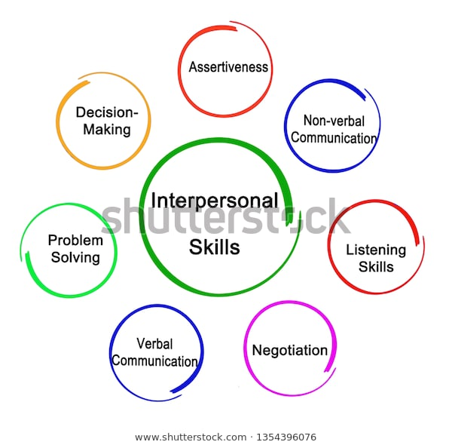
1. Interpersonal Communication

Slide 37
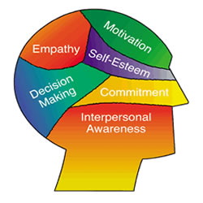
2. Intrapersonal Communication

Slide 38
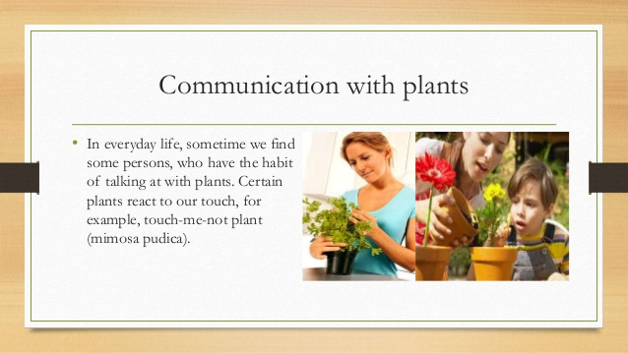
3. Extra-personal Communication

Slide 39
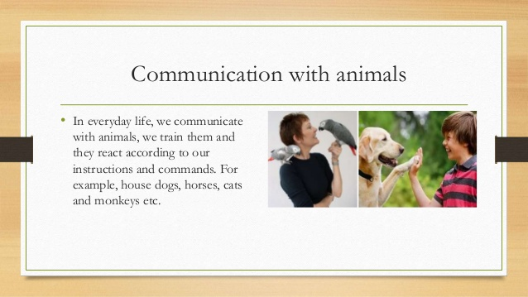

Slide 40
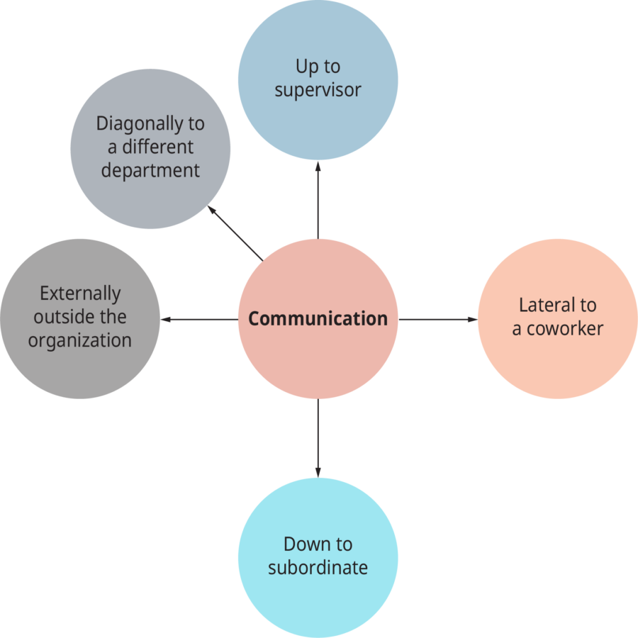
4. Organizational Communication
a. Internal operational Organizational Communication
b. External operational Organizational Communication
c. Personal- Organizational Communication

Slide 41

5. Mass Communication

Slide 42
ASSESSMENT QUESTIONS
1. Answer the following questions by choosing correct options given below.
Which one of the following is not an example of intrapersonal communication?
A. Sending a text message to a friend.
B. Talking to yourself.
C. Writing a reminder note to yourself.
D. Thinking about a problem you need to solve.
2. Group communication involves a different set of skills than interpersonal communication because
A. In a group, one sender has many different receivers to take into account.
B. In a group, one receiver has many different senders to take into account.
C. Groups, by definition, contain more than two people.
D. Group communication is more important than interpersonal communication.
3. The mode of communication that involves a single source transmitting information to a large number of receivers simultaneously, is called
A. Group communication B. Mass communication
C. Intrapersonal communication D. Interpersonal communication
4. Organizational communication can also be equated with
A. Intrapersonal communication B. Interpersonal communication
C. Group communication D. Mass communication
5. The type of communication that the teacher has in the classroom, is termed as
A. Interpersonal communication B. Mass communication
C. Face-to-face communication D. Above all

Slide 43
6. ’Orkut’ is a part of:
A. Intrapersonal communication B. Mass communication
C. Group communication D. Interpersonal communication
7. Communication with oneself is known as:
A. Group communication B. Grapevine communication
C. Interpersonal communication D. Intrapersonal communication
8. In mass communication, selective perception is dependent on the receiver’s
A. Competence B. Pre-disposition
C. Receptive D. Ethnicity
9. Interpersonal Communication is direct face to face communication between
A. Mass B. Two persons
C. Group of persons D. Oneself
10. Which of the following term is used when one communicates with himself?
A. Interpersonal communication B. Intrapersonal communication
C. Unidyadic communication D. Me communication

Slide 44
Answers
A 2. A 3.B 4.C 5.D 6.D 7.D 8. C
9.B 10.B

Slide 45
Barriers in communication
Listening barriers
2. Barriers while speaking
3. Environmental barriers include
4. Cultural barriers:
Social and Economic Conditions
Cultural Background
Language and Accent
Behavior and Nature
5. Religion
6. Individual/Psychological barriers

Slide 46
7. Organizational Barriers
8. Interpersonal barriers
9. Attitudinal barriers
10. Channel barriers
Physical and mechanical barriers
Language/Semantic barrier
(i) Words with different meaning (ii)Denotations (Dictionary meaning): and Connotation (Imaginary meaning)
(iii)Bad Expression: (iv)Faulty Translation:
(v)Unclarified Assumption:

Slide 47
Activity: Your father is not keen on your decision to study MS in the USA. How can you persuade him, bearing in mind the barriers to communication that you might encounter?

Slide 48
ASSESSMENT QUESTIONS
Exercise: 1.2. Answer the following questions by choosing correct options given below.
1. Which of these is the ‘external sound’ present in the channels of communication? a) Noise b) Semantic problems c) Cultural barriers d) Over communication
2. Which of these should not be avoided for effective communication? a) Noise b) Planning c) Semantic problems d) Wrong assumptions
3. __________ is arising from ‘expression’. a) Cultural barriers b) Semantic problems c) Wrong assumptions d) Selecting perception
4. When is the communication process complete? a) When the sender transmits the message b) When the message enters the channel c) When the message leaves the channel d) When the receiver understands the message.
5. ______ is the first enemy of communication. a) Noise b) Clarity c) Politeness d) Completeness

Slide 49
6. Which of these must be avoided for effective communication? a) Sharing of activity b) Listening c) Ambiguity d) Politeness
7. Which of these is not a commandment of effective communication? a) Clarity in language b) Listening poorly c) Home communication skills d) Adequate medium
8. ‘Faulty Translation’ is an example for _________ barrier. a) Speaking b) Environmental c) Listening d) Language/ semantic
9. Both encoding and decoding of message are influenced by our emotions. A. True B. False
10. Communication should serve as a conflict- reduction exercise. A. True B. False

Slide 50
Answers
1.A.Noise
2.B.Planning
3.B.Semantic problems
4.D.When the receiver understands the message.
5.A.Noise
6.C.Ambiguity
7.B.Listening poorly
8.D.Language/ semantic
9.A.True
10.A.True

Slide 51
B

Slide 52
Body language and its significance.
Meaning: ‘Body Language’ is a non-verbal communication where messages are sent through postures, eye-contacts, movements, usage of space and change in the intonation of voice etc. instead of using words and speech to communicate.
The following terms of body language decides the personality of an individual.
1. Open Body Language
2. Closed Body Language
3. Uncrossed Legs
4. Uncrossed Arms
5. Crossing of Arms
6. Crossing of Legs When Seated
7. Arms in Front of Body
8. Crossing of Legs in Standing

Slide 53

Gestures:
Pointing with Finger:

Slide 54
Wagging Finger Side To Side:

Slide 55

Pointing Thumb Upwards:

Slide 56

Pointing Thumb Downwards:

Slide 57

Index Finger Touching Thumb:

Slide 58
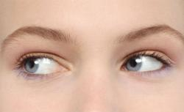
Eye Contact
Looking to Left:

Slide 59

Looking to Right:

Slide 60

Glancing

Slide 61
Significance of Body language:
1. Upgrading our Communication System/style.
2. First Impression Leaves Big Impression.
3. It's the Universal Language.
4. Meaningful communication can be possible.
5. Effective communication can be possible.
6. Avoid misunderstanding during communication.
7. Attract the viewer’s towards the communicator.
8. Create better image of the person or an individual.
9. Body language can instantly help to evaluate the interest of people.
10. It is a personal way of expressing emotions when words don’t help.
11. It can make communication more interesting and non-monotonous.

Slide 62
ASSESSMENT QUESTIONS
Answer the following questions by choosing correct options giving below.
1. Which of the following is not an example of body language?
Crossing your arms over the chest.
Drumming your fingers on the table.
Rolling your eyes.
Talking too fast.
2. Which of the following statements about body language is true?
Body language can be conscious or unconscious.
Body language includes conscious gesture.
Body language includes unconscious gesture.
Body language typically leaves negative impression.
3. The study of ‘Body Language’ is called_________
A. Verbal B. Kinesics C. Nonverbal D. None
4. “Kinesics” derived from the _____________
A. Latin word B. German word C. Greek word D. None
5. “Kinesis” means___________
A. Motion B. Run C. Speak D. Write

Slide 63
Answer
1.D. Talking to fast.
2.A. Body language can be conscious or unconscious.
3.B. Kinesics
4.A. Latin word
5.A. Motion
Activity: “Body language determines the personality of an individual”, justify the statement.

Slide 64
Body Language Across cultures:
Generalized Nonverbal Behaviors by Ethnic/Cultural Background
Cultural Background | Haptic (Touch) | Oculesics (Eye contact) | Kinesics (Body motions, gestures) | Vocalics (Tone, volume) | Posture (Body position, Stance) | Proxemics (Use of space) | Chronemics (Tim e, speed, waiting)
Typical American | Generally like touch; shake hands; youth show affection in public. | Eye contact Expected. | Used to signal; head nods affirm Wide range signal; head nods affirm. | Wide range varies by gender, age, social situation | Wide range; erect posture admired. | 30” apart | Often in a Hurry.
Africans | More formal; expect respect. | Quick eye Contact. | Nod heads to show listening. | ——— | Erect | More formal distance until know others. | Varies
Asians | Limited touch, both bowing and shaking hands; no public affection; do push in crowds | Avoid direct eye contact. | Smiling covers many emotions. | Never interrupt due to respect. | Erect and balanced posture valued. | ——— | ———

Slide 65
The following is a brief review of cultural preferences:
1. The predominant culture in the U.S:
Haptics—Americans may wish to be touched during difficult times or by close friends but generally stand 30 inches apart. Americans do shake hands.
Young Americans do demonstrate affection publicly.
Oculesics—Americans are taught to make eye contact. In terms of general kinesics, Americans use hand gestures to indicate “okay,” give “a thumbs up” for a good job, and use head nodding to affirm a speaker’s message.
2. Africans:
Oculesics: Generally behave in a more formal manner, showing politeness with quick eye contact
Gesture, Posture & Eye-contact: Erect posture, a nod of the head, and careful listening.
Haptics- They may be less interested in touching.

Slide 66
3. Asian cultures: (Chinese, Pacific Islanders, Japanese, and Koreans share much of the following):
Haptic—Asians are generally not a touch oriented society, although many cultures now use handshaking as well as bowing; public displays of affection are avoided, but pushing in a crowd is common.
Oculesics—Direct eye contact is typically avoided.
Facial expression—Smiling covers a wide range of emotions, so be certain to reflect back what you see to clarify.
Posture—Erect, balanced posture is highly valued. Silence while being spoken to is offered as a Cultural Sensitivity in Nonverbal Communication sign of respect; great care is taken not to interrupt. People from Taiwan follow behaviors similar to these but are more likely to use handshaking than any other greeting.
Americans like to use slang words and phrases that even other Americans don’t always understand. I am jazzed when that happens!
Japanese people do not like to refuse something, so they that it will be discussed “latter”. Latter meaning never.

Slide 67
Forms of greeting practicing in different countries.
1. Handshake:
United States and Canada: Firm handshake.
France: Soft, quick handshake.
Japan: Handshake with arm fully extended, accompanied by a bow.
Germany: Firm handshake. Men traditionally accompany the handshake with a slight bow.
2. Hugging and kissing:
Native Hawaiians hug and exchange breaths in a custom called “aha”.
Mexicans will usually hug upon greeting (the abrazo).
Men in many parts of the world exchange kisses on cheek and places where this is a common practice include Cuba, Portugal, Spain, Italy, Eastern Europe, and the middle east.
3. Bowing:
Asians: Many people bow in greeting.
Japan: People bow with their hands at their sides, and the depth of the bow is related to the level of respect due to the other person.
Pakistanis: use the Salam, and bow with the palm of the right hand on their foreheads.

Slide 68
4. Eye contact:
Western culture: People make intermittent eye contact while speaking to demonstrate interest and trust worthiness.
Middle East: use very intense and prolonged eye contact to gauge someone else’s intentions.
Japan: Direct eye contact is interpreted as invasion of a person’s privacy and act as rudeness.
5. Smiling:
North American: Smile automatically when greeting others.
Asian: Smile less than Westerns.
Korien: Smile usually indicates embarrassment and not pleasure

Slide 69
ASSESSMENT QUESTIONS
Exercise: 1.8.1. Answer the following questions by choosing correct options giving below.
1. From research, the following valid conclusions can be drawn about cross-cultural perceptions of facial expressions.
Members of diverse cultures do not recognize the same emotions from photographs of facial expressions.
Members of diverse cultures show significant differences in perceptions of the intensity of emotion exhibited by a facial expression.
Display rules dictate that collectivist cultures such as Singapore or China suppress exhibitions of anger or contempt toward rival group members.
None of the above
2. ‘Non-verbal’ communication is:
A. Linguistic in nature B. Single channeled
C. Less ambiguous than verbal communication D. Continuous
3. Nonverbal and verbal communications are interconnected in which of the following ways?
Nonverbal cues can repeat verbal messages
Nonverbal cues can substitute for verbal messages
Nonverbal cues can contradict verbal messages
All of the above

Slide 70
4. To communicate competently with nonverbal communication
Observe multiple nonverbal cues before drawing any conclusions about a person's communication.
Try to match nonverbal and verbal communication to avoid mixed messages
Monitor your own nonverbal communication.
All of the above.
5. The following are valid conclusions, based on research, about gestures and cultures:
Identical gestures always produce identical meaning in different cultures because gestures are natural displays of feelings.
Illustrators usually come naturally to individuals from all cultures.
There are no gestures that mean the same thing to members of different cultures.
Every culture uses the thumbs up sign to mean "good going" or "nice job".

Slide 71
6. Differences between verbal and nonverbal communication include.
Verbal communication is multichannel; nonverbal communication is single-channeled.
Nonverbal communication possesses none of the four essential characteristics of language (verbal communication).
Verbal communication is single-channeled; nonverbal communication is multichannel.
both b and c
7. Friendship-warmth touch.
Is the least intense form of touching?
Is most ambiguous type of touch?
Leads to the most misunderstandings between people.
Both b and c

Slide 72
Answer
1.B. Members of diverse cultures show significant differences in perceptions of the intensity of emotion exhibited by a facial expression.
2. D. Continuous 3. D. All of the above
4. D. All of the above.
5. B. Illustrators usually come naturally to individuals from all cultures.
6.D. both b and c
7. A. Is the least intense form of touching?
Activity: Interview two persons who are from different countries. You would need to prepare a power point presentation. Images from the country you are researching should be included based on the relevant information. Identifies and connects to cultural experiences that similar and different to one’ own.

Slide 74
Difference between General and Technical communication:
SL. NO | General Communication | Technical Communication
1 | Contains a general message. | Contains a technical or official message.
2 | Informal in style and approach. | Mostly formal style.
3 | No set pattern of communication. | Follows a set pattern.
4 | Mostly oral. | Both oral and written.
5 | Not always for a specific audience. | Always for a specific audience.
6 | Does not involve the use of technical vocabulary or graphics etc. | Frequently involves jargon , graphics etc.

Slide 75
ASSESSMENT QUESTIONS
Answer the following questions by choosing correct options giving below.
1. Technical writing demands ______ use of language. a) Figurative b) Poetic c) Factual d) Dramatic
2. Which of these must be avoided in technical writing? a) Facts b) Grammar c) Punctuation d) Personal feelings
3. Which of these words is used in technical writing? a) Apex b) Top c) Slanting d) Bottom
4. Which of these is a technical word for slanting? a) Lateral b) Sloping c) Tilting d) Bent
5. Familiar words must be used in technical writing. a) True b) False

Slide 76
6. Technical writing is same as general writing. a) True b) False
7. Participant should listen to the opinions expressed by others with respect. a) True b) False
8. ‘Personal appearance’ is an element of non-verbal communication. a) False b) True
9. A pointed finger may be a gesture of accusation. a) True b) False
10. Non-verbal communication includes all external stimuli apart from words uttered. a) False b) True

Slide 77
Answer
1.C. Factual
2.D. Personal feelings
3.A. Apex
4.A. Lateral
5.A. True
6.B. False
7.A. True
8.A. False
9.A. True
10.A. False
Activity: How do you differentiate whether person is using general or technical communication? Illustrate with real-time experience.

Slide 79
1. Section-A: Google Classroom Class code=vs2wqpg
2. Section-B: Google Classroom Class code= gyokngm
3. Section-C: Google Classroom Class code= dbubbjx
4. Section-D: Google Classroom Class code= xlyf3co
5. Section-E: Google Classroom Class code= zffnvmk
6. Section-F: Google Classroom Class code= cbuyboh

